Slide 1
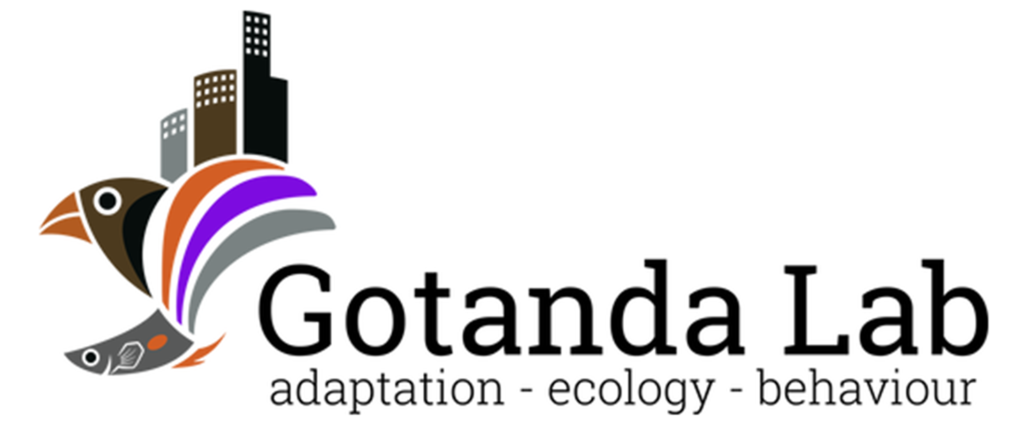

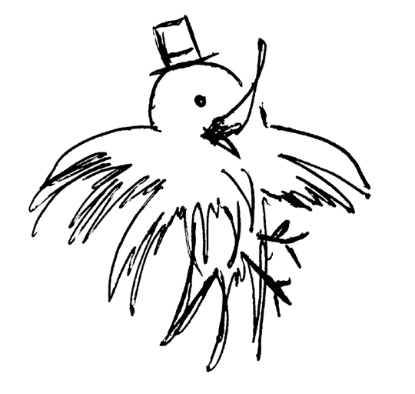
Sentinel behaviour in mammal and avian species
Alex Popescu, Dr. Kiyoko M. Gotanda
Department of Biological Sciences, Brock University
OE3C 2024

Slide 2




Sentinel behaviour
A form of coordinated vigilance:
- Individuals take turn being vigilant over other group members.
- Can result in increased safety and foraging efficiency in foragers.
- Sentinel loses foraging opportunities.
Lost foraging opportunity
Why do sentinels perform the behaviour if it is costly?
↑ Foraging efficiency
↓ Predation risk

Slide 3

Selfless or selfish?
Sentinel behaviour was originally thought to be a selfless behaviour.
↑ Foraging efficiency
↓ Predation risk
Lost foraging opportunity
Sentinel
Forage
Costs of sentinel behaviour compensated by the actions of other sentinels.

Slide 4




Selfless or selfish?
More recently, empirical studies support the selfish, state-dependent model for sentinel behaviour.
Sentinel present
Sentinel Absent
Decision to perform sentinel behaviour dependent on individual’s energetic state & need for safety.
Lost foraging opportunity
↑ Risk
Earlier threat detection

Slide 5
Decisions, decisions…
The decision to perform sentinel behaviour could therefore be affected by factors both intrinsic and extrinsic.
Sentinel present
Sentinel Absent
Understanding the effects and interactions between these factors can provide insights into the decision-making of similar behaviours.
Lost foraging opportunity
↑ Risk
Earlier threat detection

Slide 6
Objectives
Our objective was to identify and analyze the factors involved in the decision to perform sentinel behaviour.
To do so, we did a scoping review and searched Web of Science for empirical studies on sentinel decision-making.
We predicted that both intrinsic and extrinsic factors would significantly alter sentinel behaviour.

Slide 7
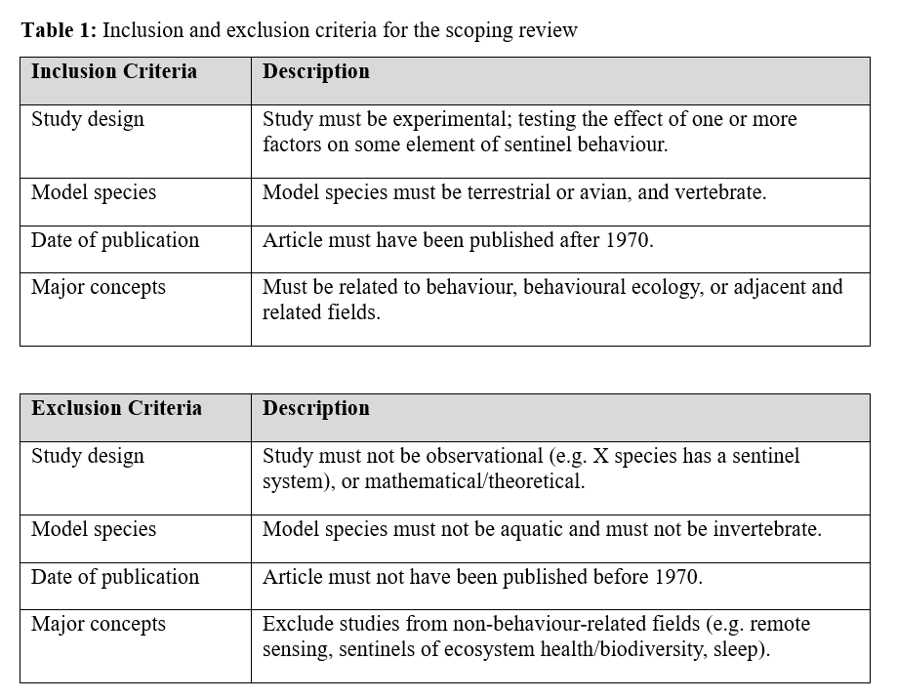
Methods
We searched Web of Sciences on Nov. 1st, 2022
- “Sentinel AND Behavio*” as keywords
- Filtered by major concepts

Slide 8
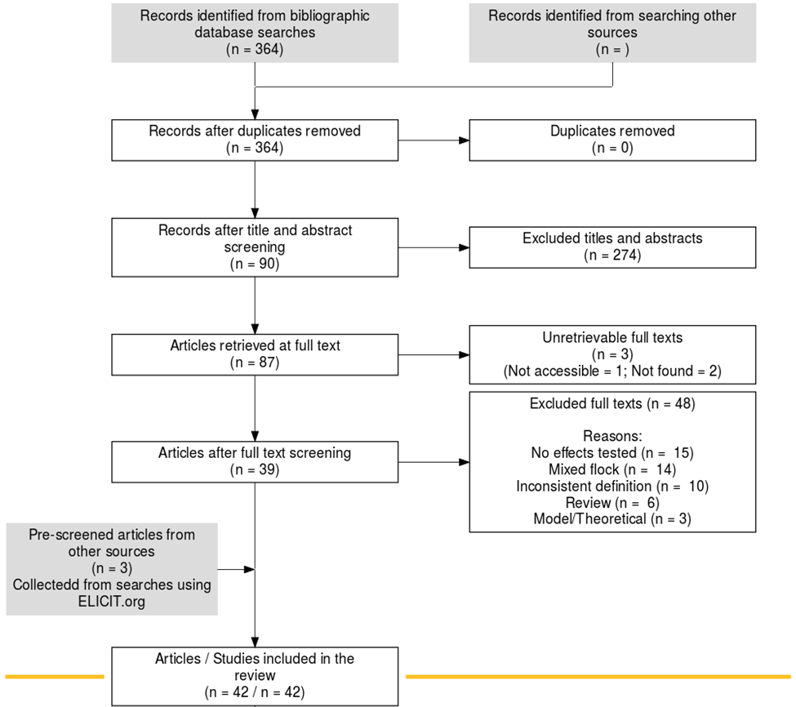
Search Results
Search string returned 364 records.
After screening, we retained 42 studies that fit our inclusion criteria.

Slide 9
Trends observed
The effects of several intrinsic and extrinsic factors were common in both mammal and avian species, including:
Intrinsic factors such as sex, age, body mass, and satiation
Extrinsic factors such as dominance, group size, and risk
Notes:
Talk more about the implications of intrinsic and extrinsic factors

Slide 10
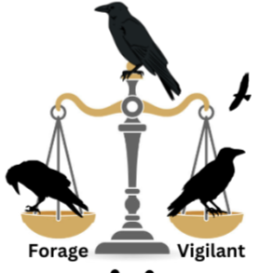
Discussion: Sex and Maturity
Sex:
- Males sentinelled earlier, more frequently and for longer than females of the same dominance rank
Forage
Sentinel
Notes:
Use figures from literature to prove point

Slide 11
Discussion: Body mass & Satiation

Slide 12
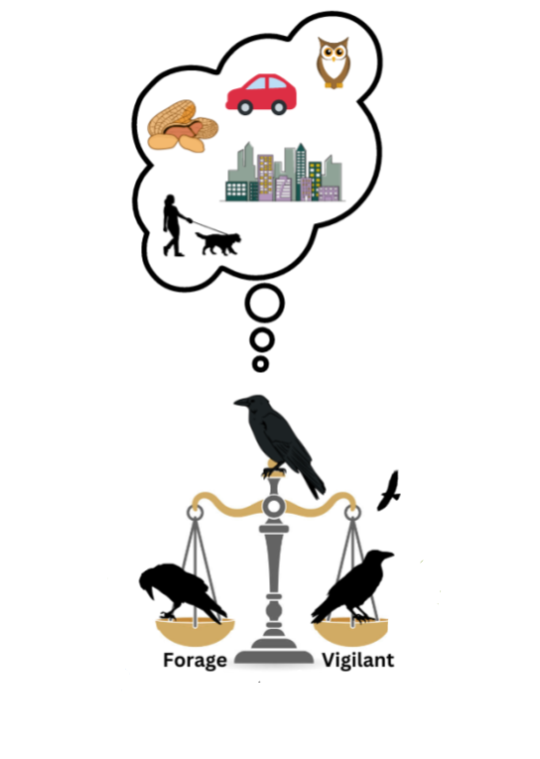
Discussion: Extrinsic factors
Factors identified:
- Dominance
- Group size
- Risk
Forage
Sentinel

Slide 13
Discussion: Dominance & Group Size

Slide 14
Discussion: Risk

Slide 15
Conclusions
Notes:
What research remains to be done? Need to take a holistic approach as intrinsic and extrinsic factors can interact

Slide 16

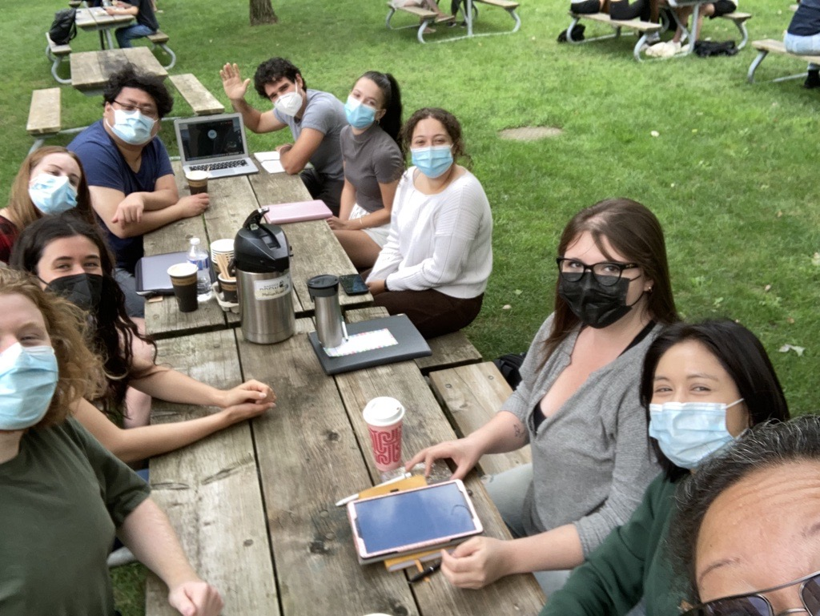

Aknowledgements
My supervisors: Dr. Kiyoko Gotanda, Dr. Liette Vasseur, Dr. Anne Clark
The Gotanda Lab
My family and friends

Slide 17
Questions?

